Slide 1

React.js
Course Overview, Trainers, Evaluation
SoftUni Team
Technical Trainers
Software University
https://softuni.bg/

Slide 2

Table of Contents
Course Overview
Course Objectives
Course Topics
Trainers Team
Exams and Evaluation
Learning Resources

Slide 3
Have a Question?
sli.do
#js-web

Slide 4

React.js

Slide 5
Course Objectives
The React.js course provides
Fundamental understanding of JSX and React
Covers component-based architecture
Establishes Immutable UI concepts
What is NOT covered?
JavaScript basics and REST communication
Optimization and Web Components

Slide 6
Not for Absolute Beginners
The "React.js" course is NOT for absolute beginners
Requirements
HTML & JS (ES 2016) - intermediate level
Our HTML & CSS Mini Course can help you
Computer English - entry level

Slide 7
Course Topics
React.js overview, JSX syntax
Components, state, props
Events, Lifecycle, HOC, CSS Modules
Routing
Forms
React Hooks and Context API

Slide 8

The Team

Slide 9
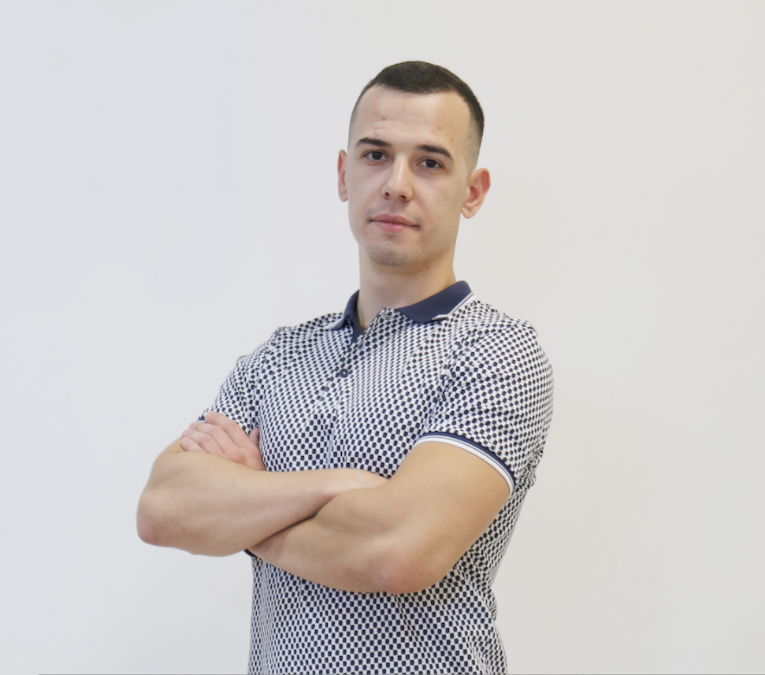
Valentin Georgiev
Lead Software Engineer
Co-organizer
Serverless Bulgarian Meetups
Speaker on
jsTalks()
React
Developer with entrepreneur mindset

Slide 10

Course Organization

Slide 11

Training Duration
Lessons: ~30 hours (onsite + videos)
Practical Workshop (in class): ~30 hours
Project Defense: 15 minutes
Defense date: 16 August 2020
Retake defense date: 23 August 2020

Slide 12


Scoring System for the Course
Theoretical Exam 5%
Project Defense 95%
Evaluation

Slide 13
Theoretical Exam
You will have 30 minutes once you enter
Multiple-choice with 1 correct answer
English
Automated quiz system
Available online
You can submit your answers just one time

Slide 14

Learn to Search Online
The course assignments require searching online
This is an important part of the learning process
Some exercises intentionally have no hints
Learn to find solutions!
Software development includes everyday searching and learning
No excuses, just learn to study!
Developers learn new technologies, tools, languages every day!

Slide 15




Course Web Site, Forum and FB Group
Official web site:
Official discussion forum:
Official Facebook group:
Official SoftUni JavaScript Community:
softuni.bg/trainings/2452/
softuni.bg/forum/categories/107/
facebook.com/groups/JSWebSeptember2019/
facebook.com/groups/SoftUniJavaScriptCommunity/

Slide 16
Questions?
Notes:
16

Slide 17












SoftUni Diamond Partners

Slide 18




SoftUni Organizational Partners

Slide 19
Trainings @ Software University (SoftUni)
Software University – High-Quality Education, Profession and Job for Software Developers
softuni.bg
Software University Foundation
softuni.foundation
Software University @ Facebook
facebook.com/SoftwareUniversity
Software University Forums
forum.softuni.bg
Notes:
19

Slide 20

License
This course (slides, examples, demos, exercises, homework, documents, videos and other assets) is copyrighted content
Unauthorized copy, reproduction or use is illegal
© SoftUni – https://softuni.org
© Software University – https://softuni.bg
Notes:
20

